Slide 1

Auto-INSURANCE
Group 04 (Section 001)

Slide 2


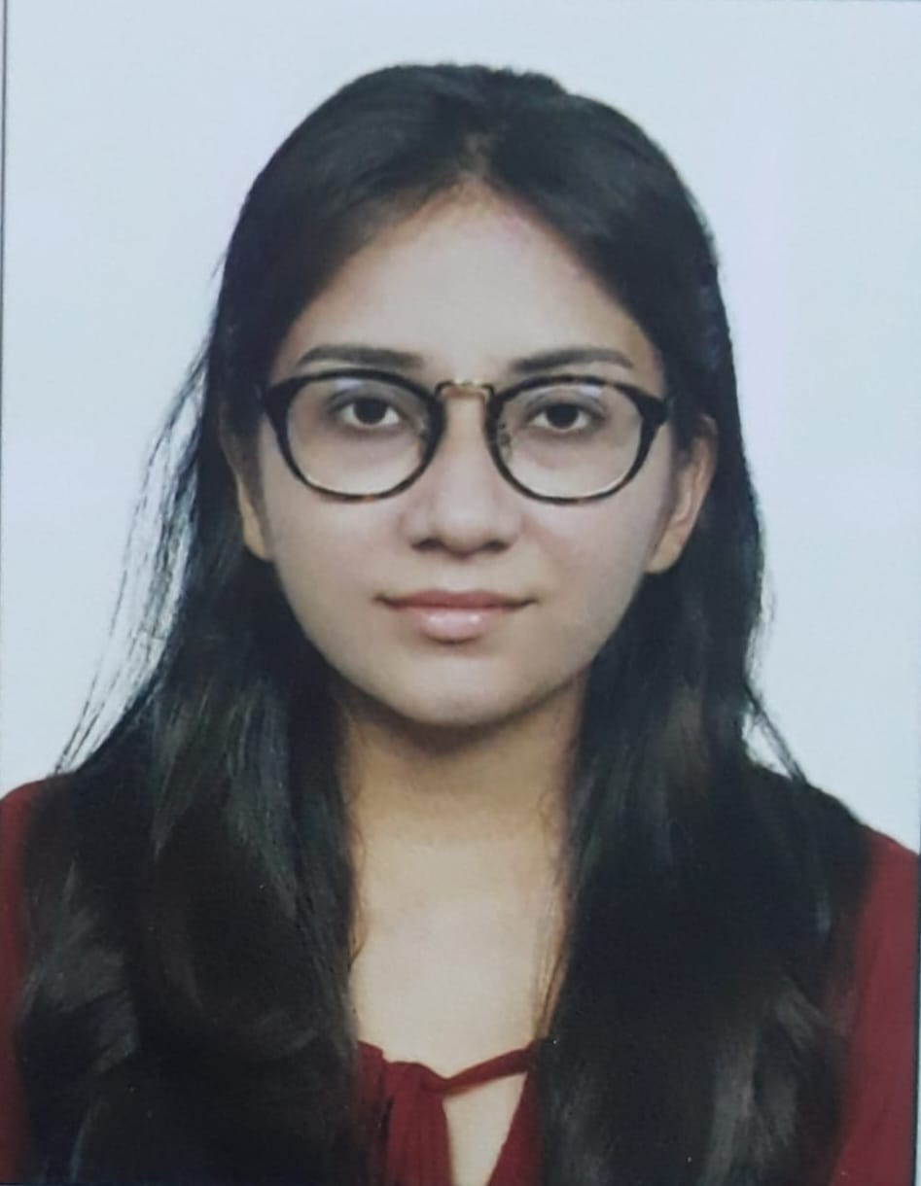
MEET OUR TEAM Group 04(section-001)
Bhumit Navadiya
Jaykumar Mangroliya
Khushi Patel
Hiren Koradiya

Slide 3
The number of accidents are increasing as compared to past years.
SOURCE: United States Department of Transportation
https://www.nhtsa.gov/press-releases/early-estimates-first-quarter-2022
The increasing ratio of accidents often result in larger claim amounts, which impacts profit for insurance companies as insurance companies make their primary income by charging premiums to customers for insurance coverage.
Ultimately, insurance companies ensure the premiums are greater than any future claims to make profits (known as underwriting profit). This motivated us to help insurance companies with an analysis model which will help them revise their policies and premiums to maximize their profit.
https://www.fe.training/free-resources/fig/how-do-insurance-companies-make-money/
Background/Motivation

Slide 4
Problem Statement
The amount of insurance claims and frauds directly influence the profit margin. While this is an established base, the problem here is understanding and finding insights from huge data easily and efficiently that will help insurance companies make improvement to direct the sales and business path. Our analysis will facilitate the same.
SOURCE: https://www.semutual.nb.ca/news/insurance-fraud/

Slide 5
Proposal
Our goal is to create analysis to recognize patterns in claim amounts and accidents to help insurance revise their policies, which help maximize their profit margin.

Slide 6
Analysis Questions:
Analyze which states have higher accidents?
Which severity class had a greater number of incidents? Also analyze which gender is higher for each one.
After an accident which authorities were contacted?
Analyse for both gender premium amount and total claim amount.

Slide 7
Data Description

Slide 8
Dataset Description
Auto-Insurance
Categorical Variables
policy_bind_date
policy_state
policy_csl
insured_sex
insured_education_level
insured_occupation
insured_hobbies
insuredrelationship
incident_type
Numeric Variables
months_as_customer
age
policy_number
policy_annual_premium
umbrella_limit
insured_zip
capital-gains
capital-loss
This is a US insurance companies dataset collected from multiple data points, uploaded on databricks. This is for the year of 2015 and covers months of January, February and March.

Slide 9
Data Visualization

Slide 10
Summary Statistics
Key Observations :
Average year of taking insurance is by age is 19 and maximum is 64 according to the dataset.
Average number of vehicles is 1 for accidents and maximum is 4.
Maximum Total Claim amount is 114920.00 and the maximum claim amount between injury, property and vehicle claim is for vehicle claim at 79580.00

Slide 11
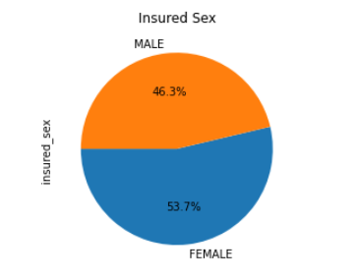
Male vs Female
It can be observed that there is not major difference between the insurance coverage for males and females, however female ratio is higher.

Slide 12
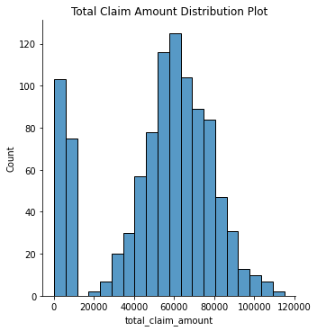
Bar chart of Total claim amount
It can be observed that the data is almost symmetrically distributed.
Which indicate the values occur at regular frequencies and are concentrated near the mean.
It is also visible that the total claim amount few policy holders is zero.

Slide 13
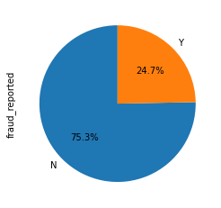
percentage of fraud
The visualization describes how much fraud reports has been reported by yes and no in percentage.`
We observe the number of frauds are less compared to true incidents.
However, the ratio of fraud incidents is at 24.7% is not insignificant.

Slide 14
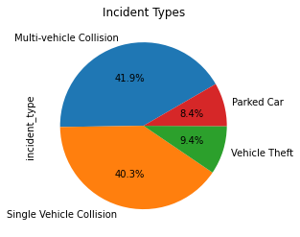
Calculating the percentage of different incident types
According to data, multi-vehicle collision incidents are slightly more then single vehicle collision.
Contrary to that, accidents of parked cars and vehicle theft is less than 10 percent then others.

Slide 15
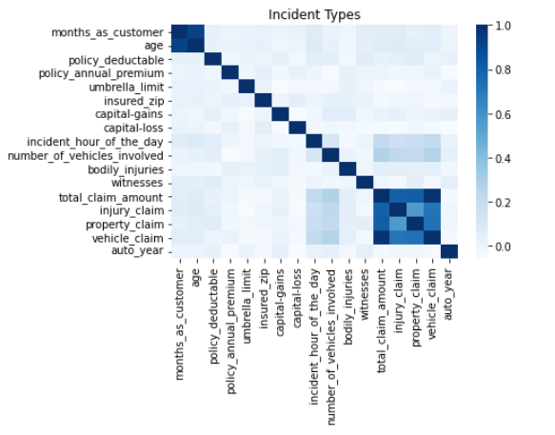
Understanding the influence of variables on each other
No strong correlation between elements between the variables.
However, we do see weak but notable correlation between total claim amount and number of vehicle involved and incident hour of the day.

Slide 16
Data analysis

Slide 17
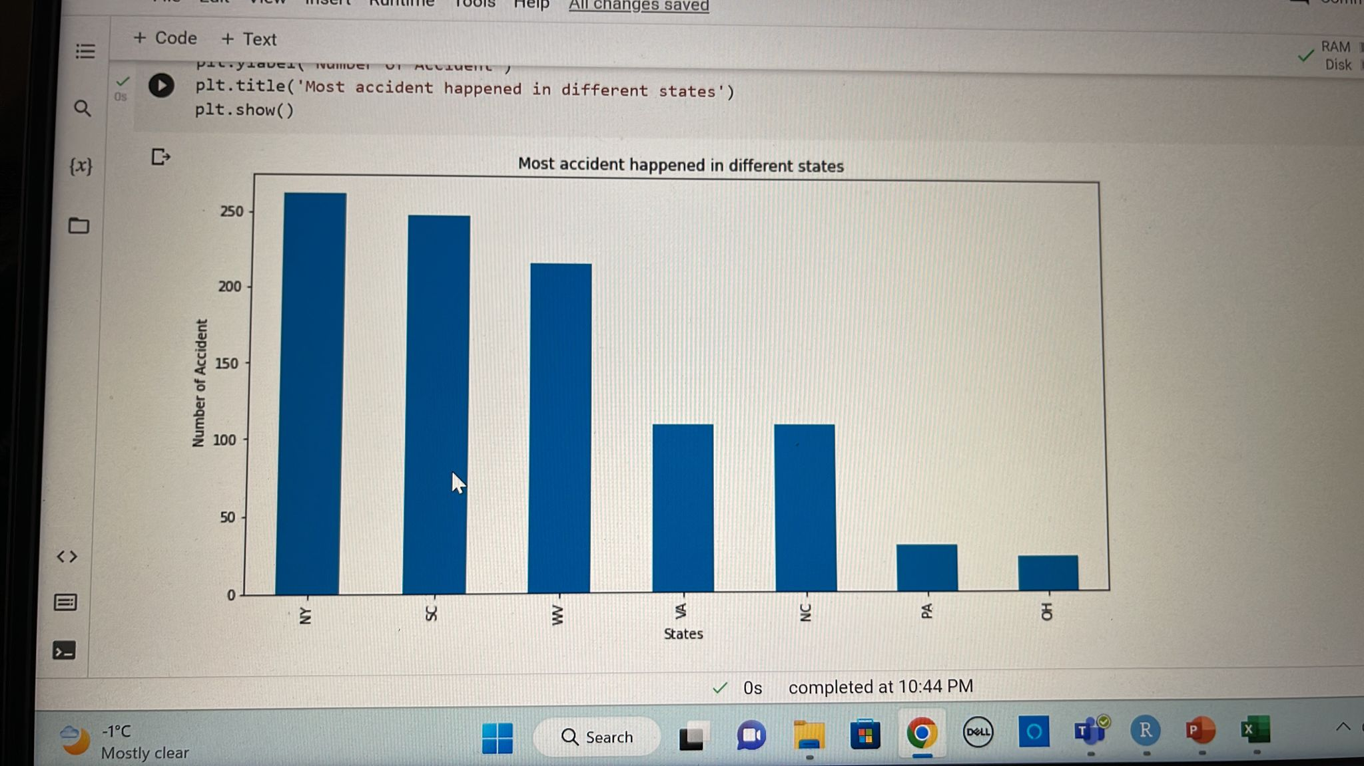
Analyze which states have higher accidents?
This graph helps understand the demographic distribution of accidents across US states.
It can be observed that New York, South Carolina and West Virginia have the highest number of accidents.

Slide 18
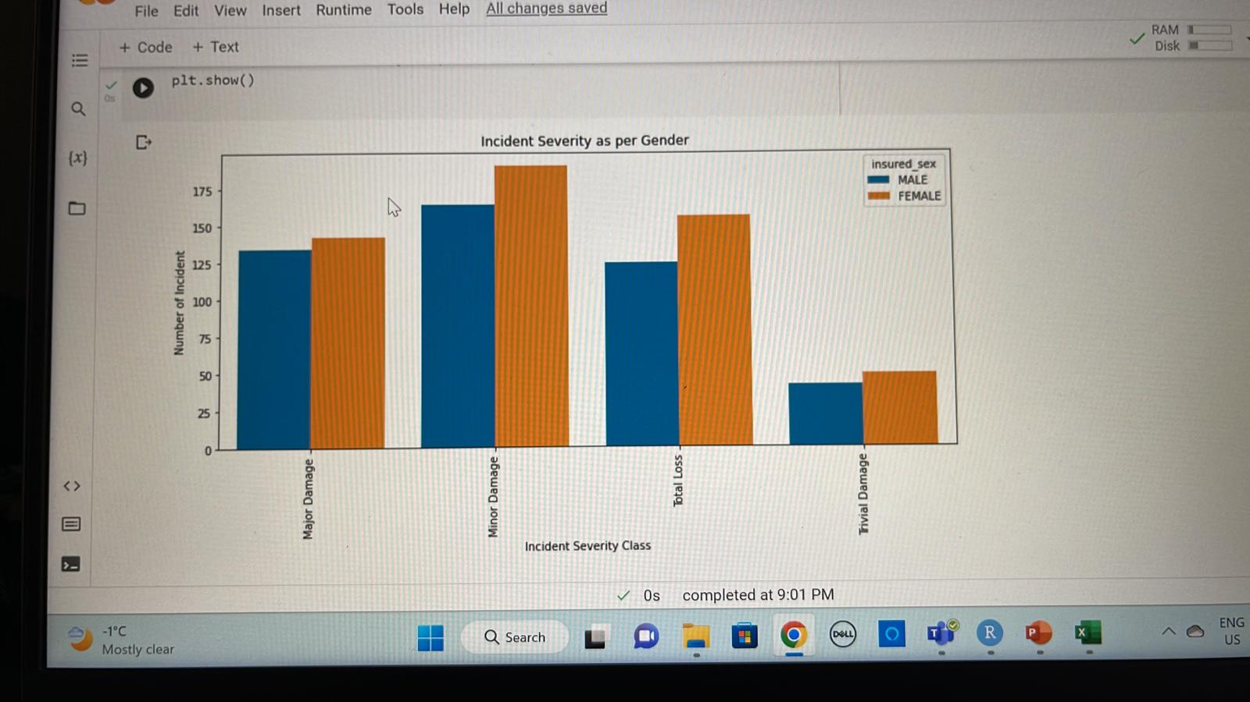
Which severity class had a greater number of incidents? Also analyze which gender is higher for each one.
This histogram compares males to females for the severity of accidents that have happened.
It can be observed that for all severity classes females have higher ration than males.
Additionally, except for trivial damage all other severity class have larger values, implying more claim amounts.

Slide 19
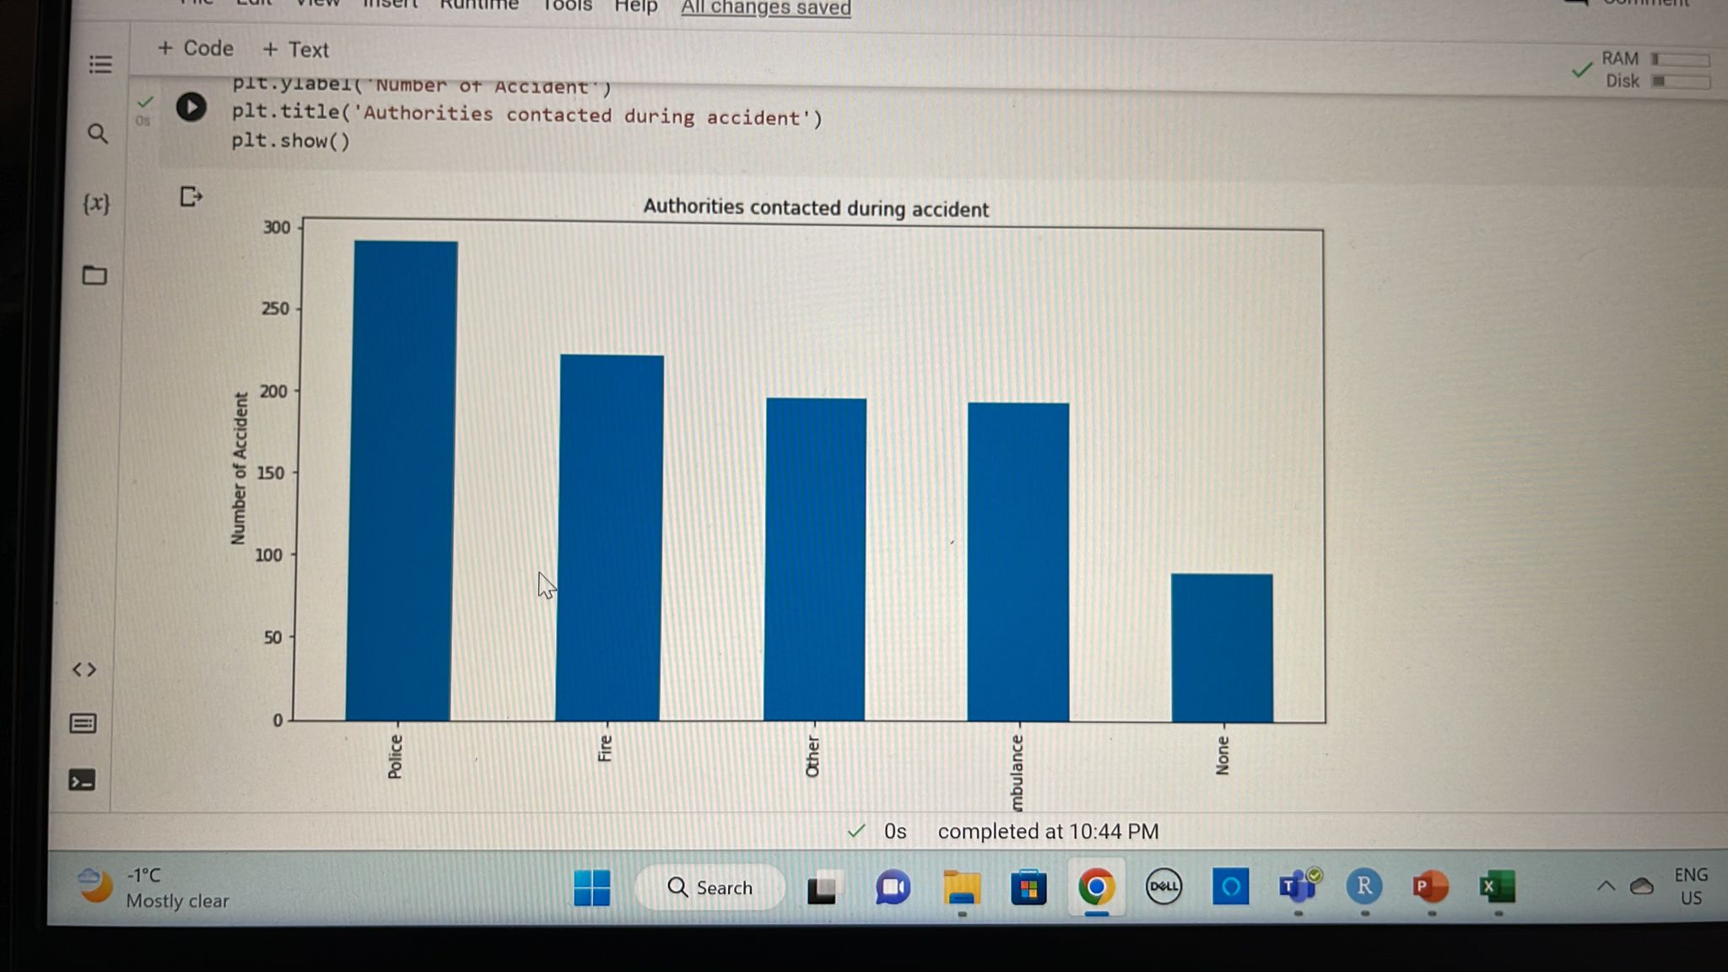
After an accident which authorities were contacted?
This bar graph gives the count for different authorities that were contacted after an accident.
It can be observed that Police was called for majority of the incidents and many accidents did not call any authority.

Slide 20
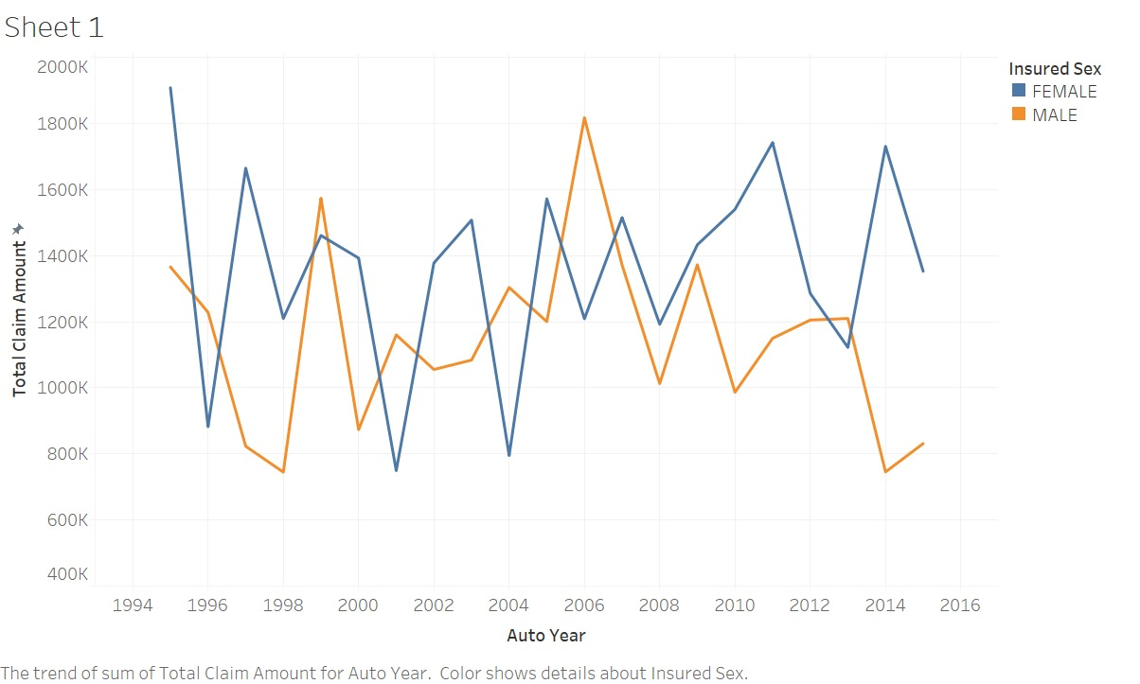
Analyse for both gender premium amount and total claim amount.
This graphs helps understand the relation of both genders in accordance to auto-mobile year vs the total claim amount and premium paid.
It first plot interprets that females have slightly higher premium amount than males.
Additionally, the premium amount has higher trend for females with auto years that are older as compared to males.
Lastly the claim is lower for males for new vehicles as compared females.

Slide 21
Conclusion

Slide 22
Our analysis conclude that policies are brought for all age groups starting 18 years to 64 year. And females have more accidents as compared to males, wherein they also have more ration in all severity class. It can be observed that New York, South Carolina and West Virginia have the highest number of accidents. Additionally, except for trivial damage all other severity class have larger values, implying more claim amounts. Further, police was called for majority of the incidents and many accidents did not call any authority, which should be noted. Importantly, The total claim amount is higher for females then males.

Slide 23
Recommendations

Slide 24
Since demographic data according to the pattern observed highlights that some states especially, New York, South Carolina and West Virginia have more number of accidents, thus the policy makes need to increase the premium amount for vehicles in that areas. Also it is highly recommended that the premium amount must be set considering the same for other four states.
As females have higher ration in the claim amount and also severity class the premium and coverage for them should also be increased to maximize profit.
Importantly, for policy holders that had total loss, and major loss the amount of premium should be increased for upcoming term. Similarly for minor loss claim policy holders the amount can be increased but at comparatively lower rates (this recommended as though the amount is claim small but according to data the number of such incident is huge, which implies the sub total claim amount could be higher. )
Lastly, for incidents that did not call any authorities after the accident and yet applied for claim amount should be red flag due to higher probability of them being fraudulent.

Slide 25
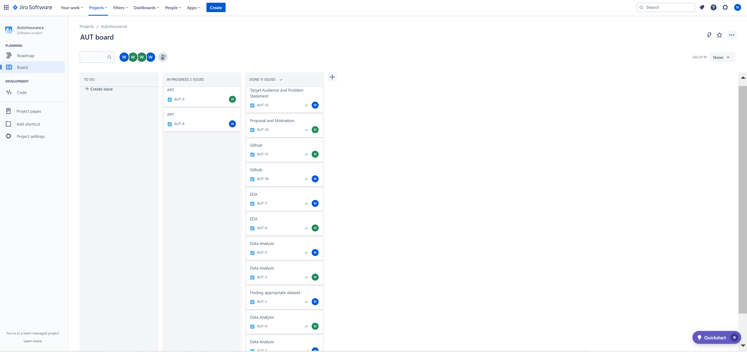
JIRA Dashboard

Slide 26
Tableau Dashboard tableau public:- https://public.tableau.com/app/profile/jay.mangroliya/viz/Auto_insurance_16712490638240/Dashboard1?publish=yes

Slide 27
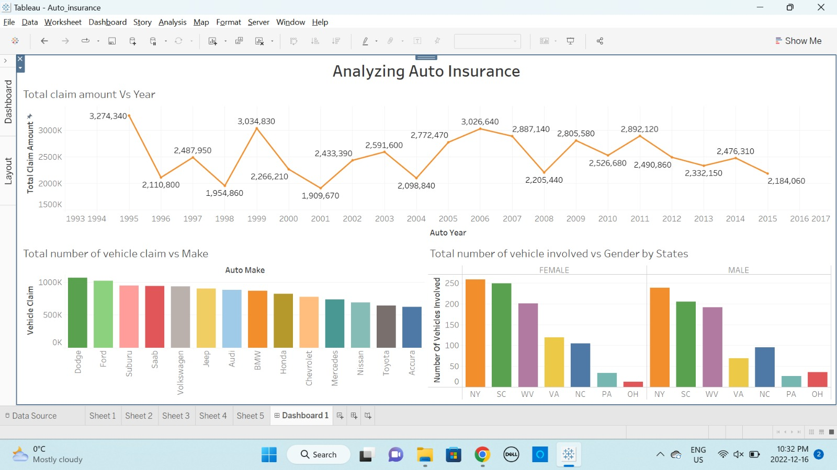

Slide 28
Github work
https://github.com/Jaymangrolia21/DAB-103-004/tree/main

Slide 29
Reference
https://databricks-prod-cloudfront.cloud.databricks.com/public/4027ec902e239c93eaaa8714f173bcfc/4954928053318020/1058911316420443/167703932442645/latest.html
https://unacademy.com/content/jee/study-material/mathematics/symmetrical-distribution/
https://www.semutual.nb.ca/news/insurance-fraud/

